Slide 1

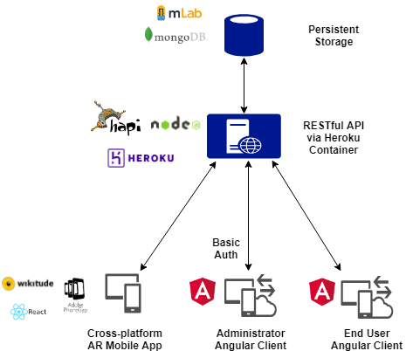
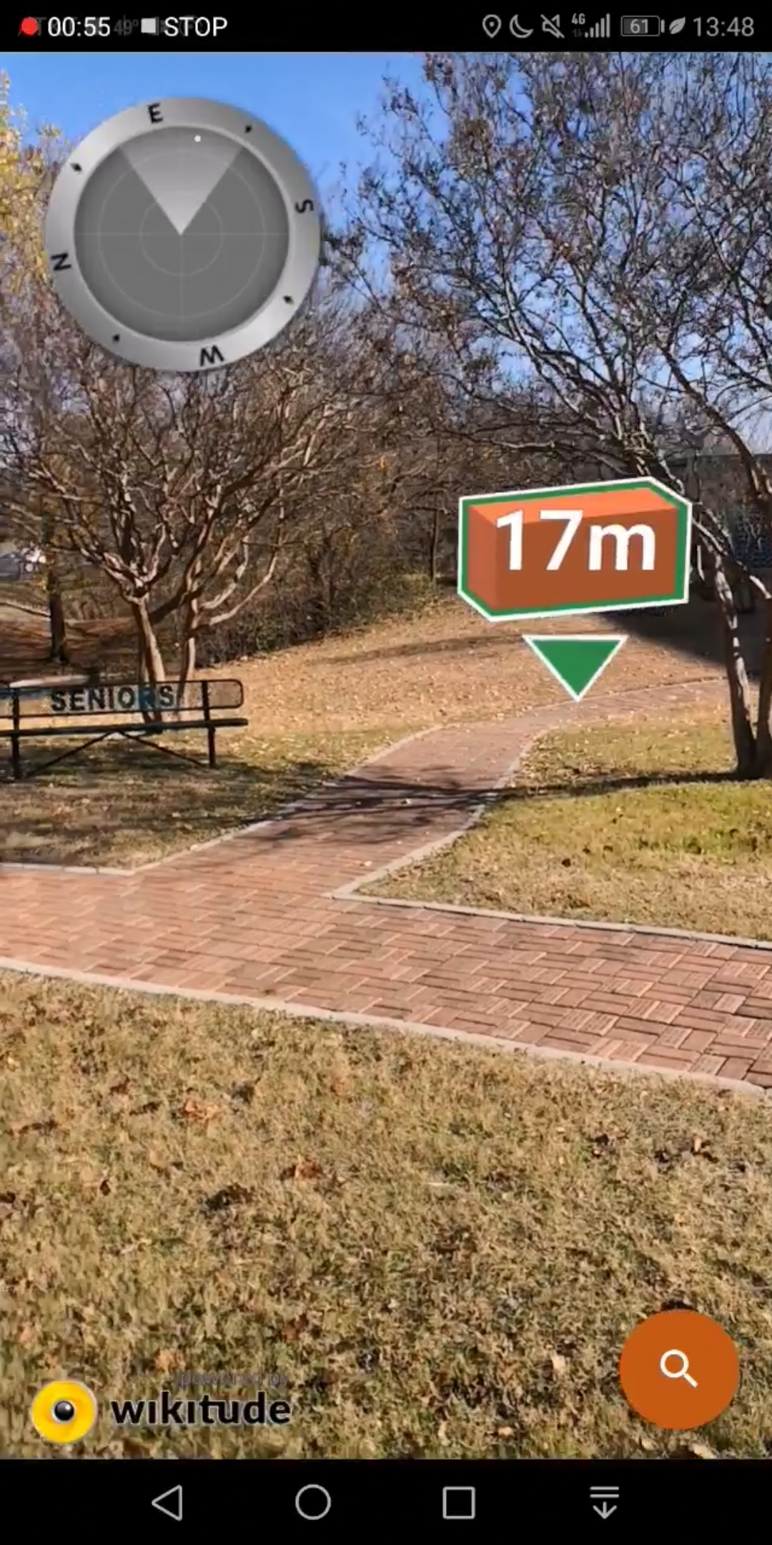
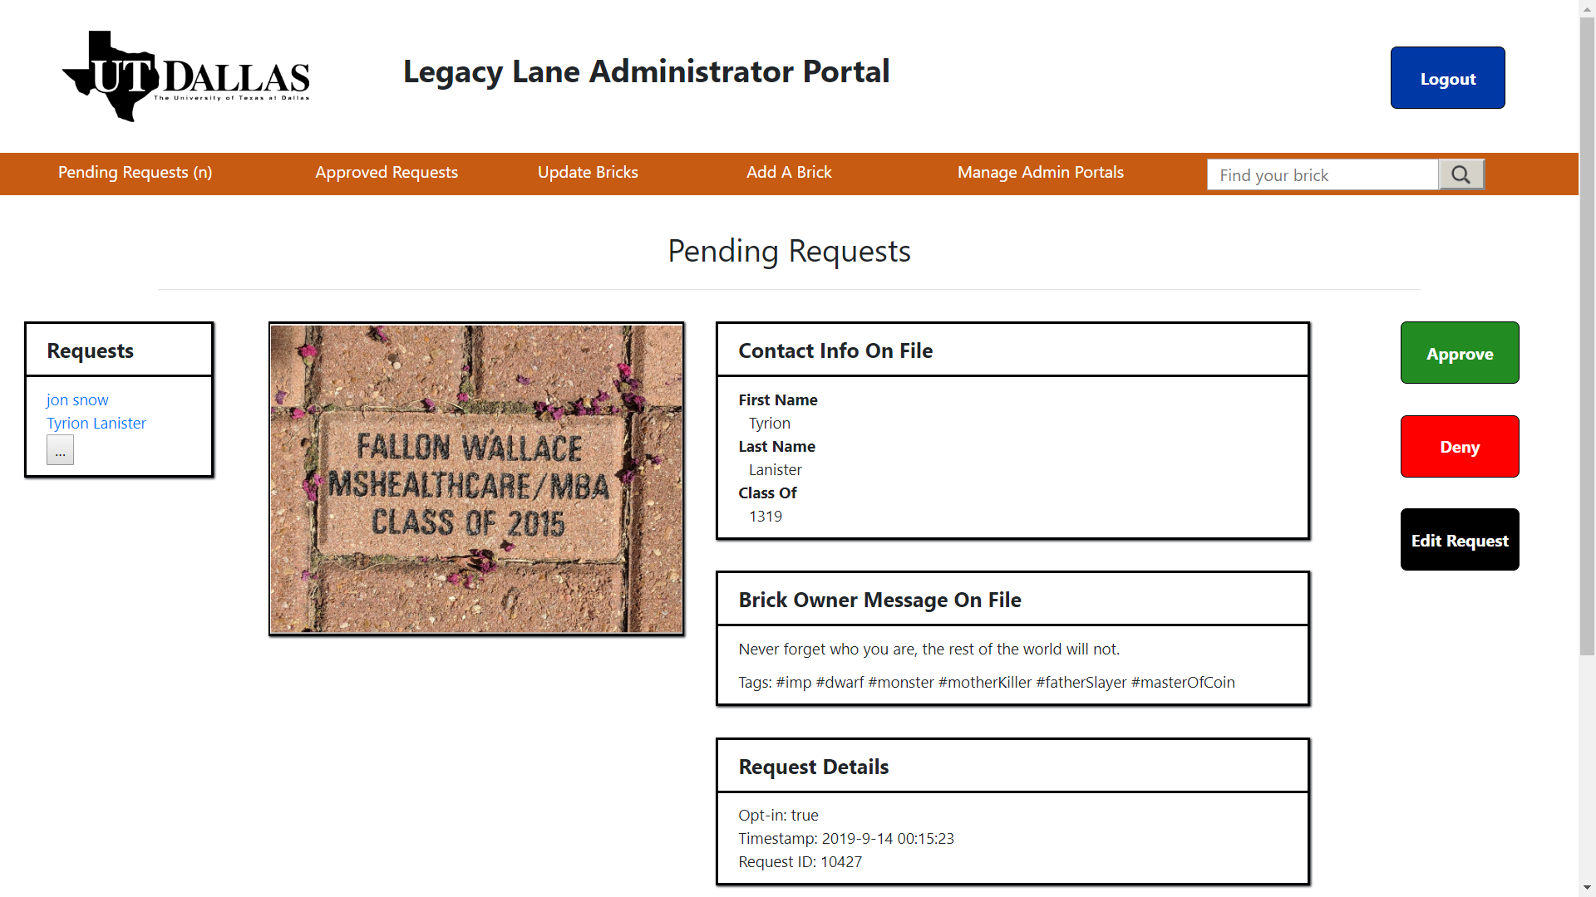
UTD Legacy Lane
Marie Standeven Devon Hayworth Daniel Casper James Speights Lucas Castro
Goal: Create an interface for alumni to interact with Legacy Lane through an augmented reality (AR) app and related web applications.
Approach: web applications paired with AR-based mobile app.
RESTful API backend
Administrator web app
End-User web app
Mobile AR application
Features:
Mobile AR App - search for a brick and navigate physically to the brick
End-User Web App – claim a brick to add content (tags, comments)
Administrator App
review and approve brick claims
create, delete, and update bricks

